Slide 1

Can We Out-scout the Scouts ?
Beau Spratt, Matthew Smith, Matthew Spitulnik and Sintia Stabel
Notes:
Introduction to the project -

Slide 2
Introduction
Compile features from a scouting report using text mining
Build labels for a supervised dataset
Calculate sentiment and topics
Predict which players are a bust
Notes:
Given the importance and impact of the NBA draft analysis has on players and teams' performance, evaluating the reliability of such reports is a crucial step in player selection and team strategy
Talk about other stakeholders, who can benefit from accurate Draft Analysis and Predictions beyond teams and players

Slide 3
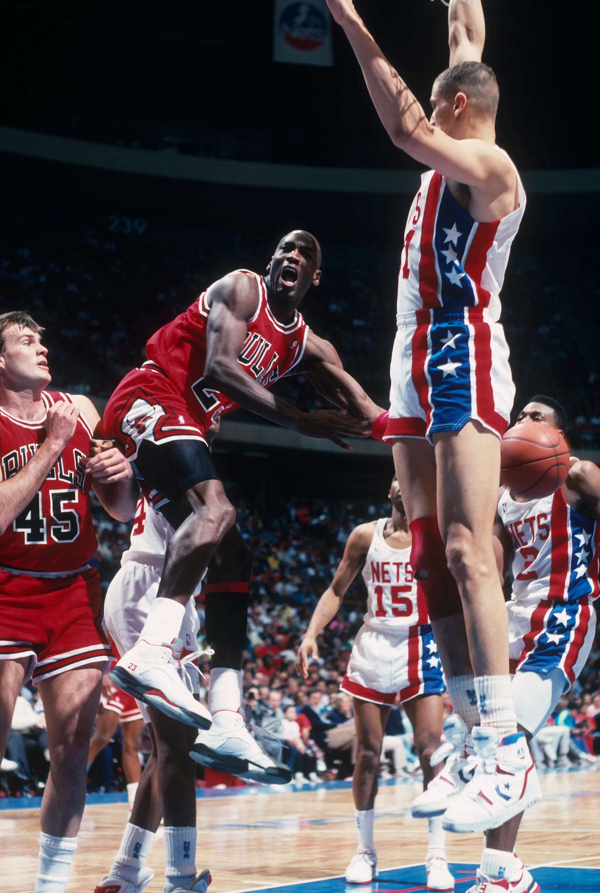
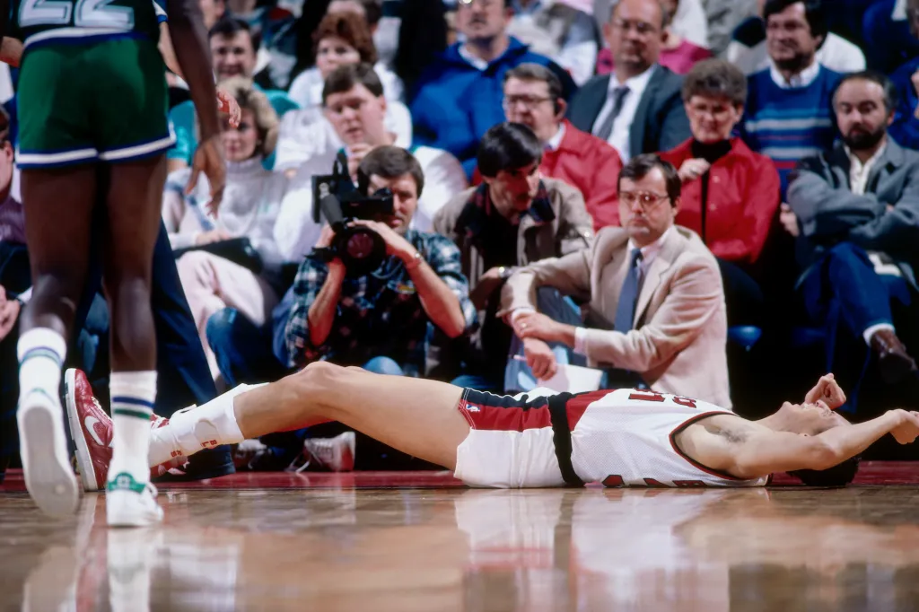
Why is it so Important? The economy of Lebron James
Within one mile of the stadium where LeBron plays, the number of bars and restaurants grew by 13%.
The number of employees working at bars and restaurants within one mile grew by 23.5%.
Legal document site FormSwift conducted a study that estimated that when King James went to Los Angeles, he would bring 3,000 jobs and $29 million in state tax revenue with him for a total five-year economic impact of $396 million.
https://www.yahoo.com/video/lebron-effect-economy-city-plays-110055812.html
https://nypost.com/article/the-15-biggest-nba-draft-busts-of-all-time/

Slide 4
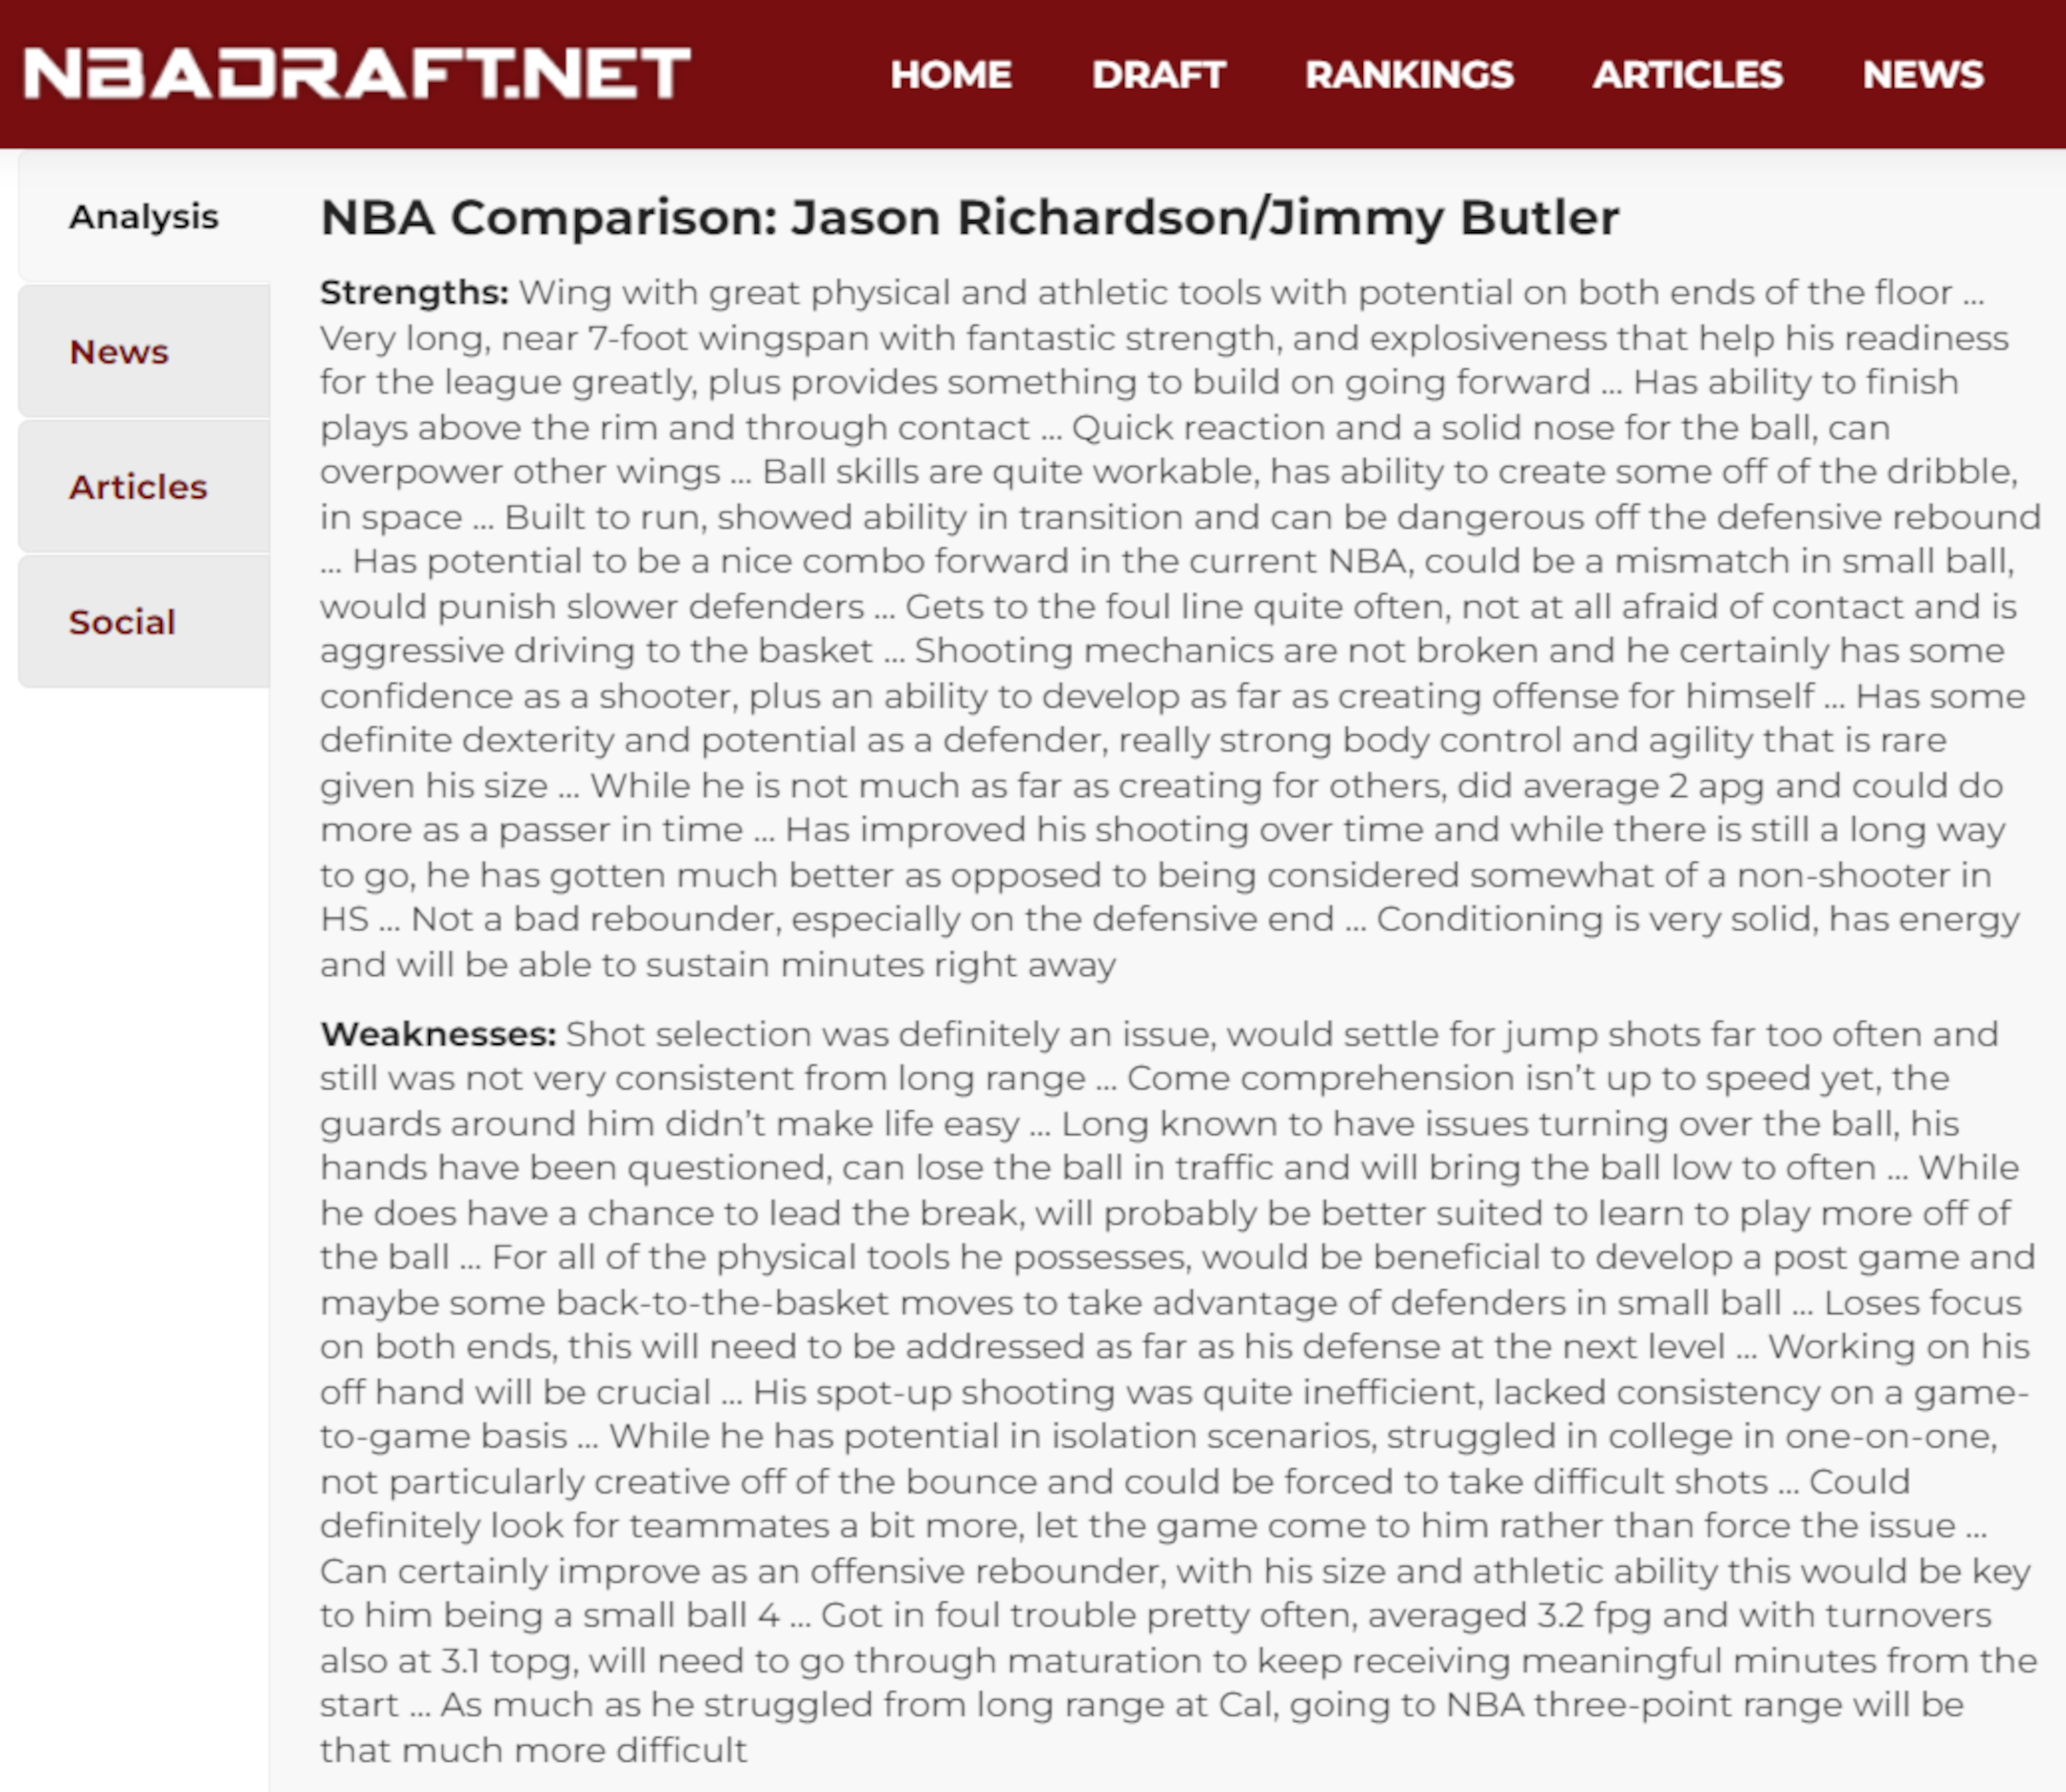


Data Collection & Labels
NBA Draft info/basic stats from nba_api, an API Client for www.nba.com.
Scouting Reports from NBADraft.NET: Strengths and Weaknesses.
Advanced stats from Basketball-Reference.com: PER,WS/48,VORP
Are the players a Bust​
Y, N, TBD, MID Labels​
Formulaic Approach :​
Bust 1: >6K Minutes​
Bust 2: Basic Stats
Bust 3: Adds MID Label
Bust 4: Advanced Stats​
​

Slide 5
Naïve Bayes Model Variations
Strengths/Weaknesses/Strengths + Weaknesses
4 Steps in Cleaning Process
CountVectorizer versus TfidfVectorizer
Single Words versus Bigrams
Multinomial versus Bernoulli
Tested Against All 4 Bust labels
384 Unique Model Variations X Cross-validation 10 times = 3840 models ran

Slide 6
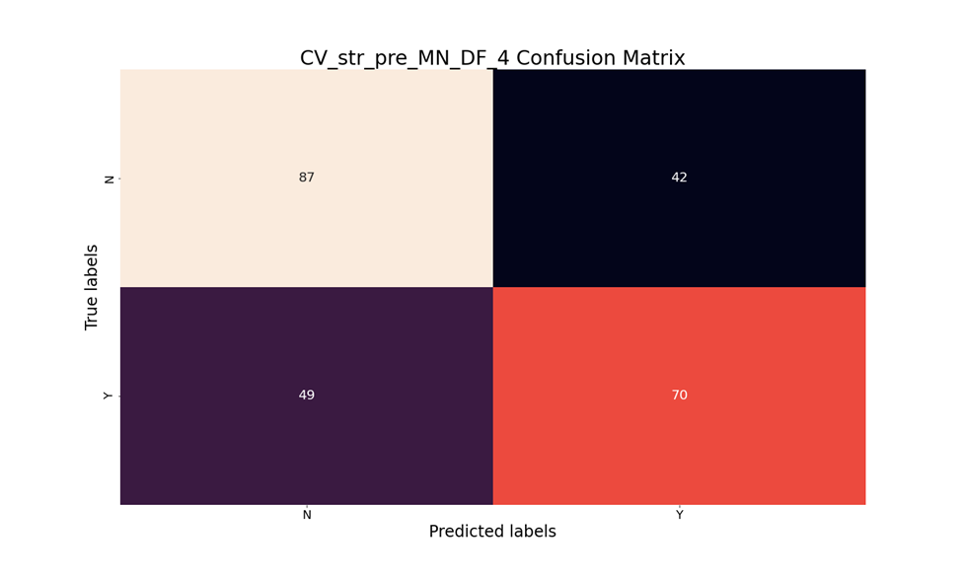
NB Performance
Highest performing model:
"Strengths" Only Text
Before Cleaning
CountVectorizer
Multinomial
Single Words
Bust4
62% Accuracy

Slide 7
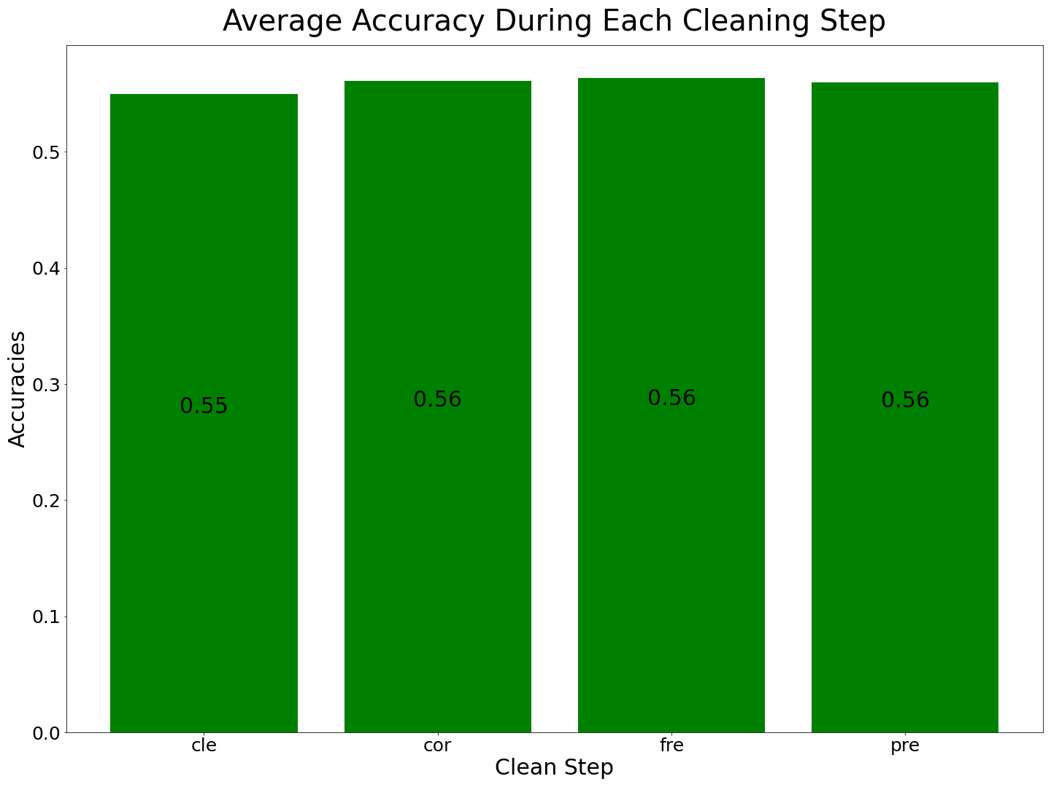
NB Performance Continued
Accuracies Fairly Equal Across Cleaning Steps
Frequency Removal Slightly Highest

Slide 8
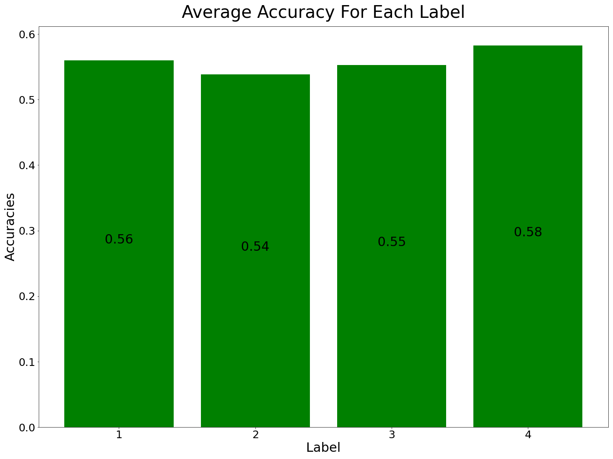
NB Performance Continued
Label 4 (Advanced Stats): Most Accurate at ~58%
Label 2 (Basic Stats): Least Accurate at ~54%

Slide 9
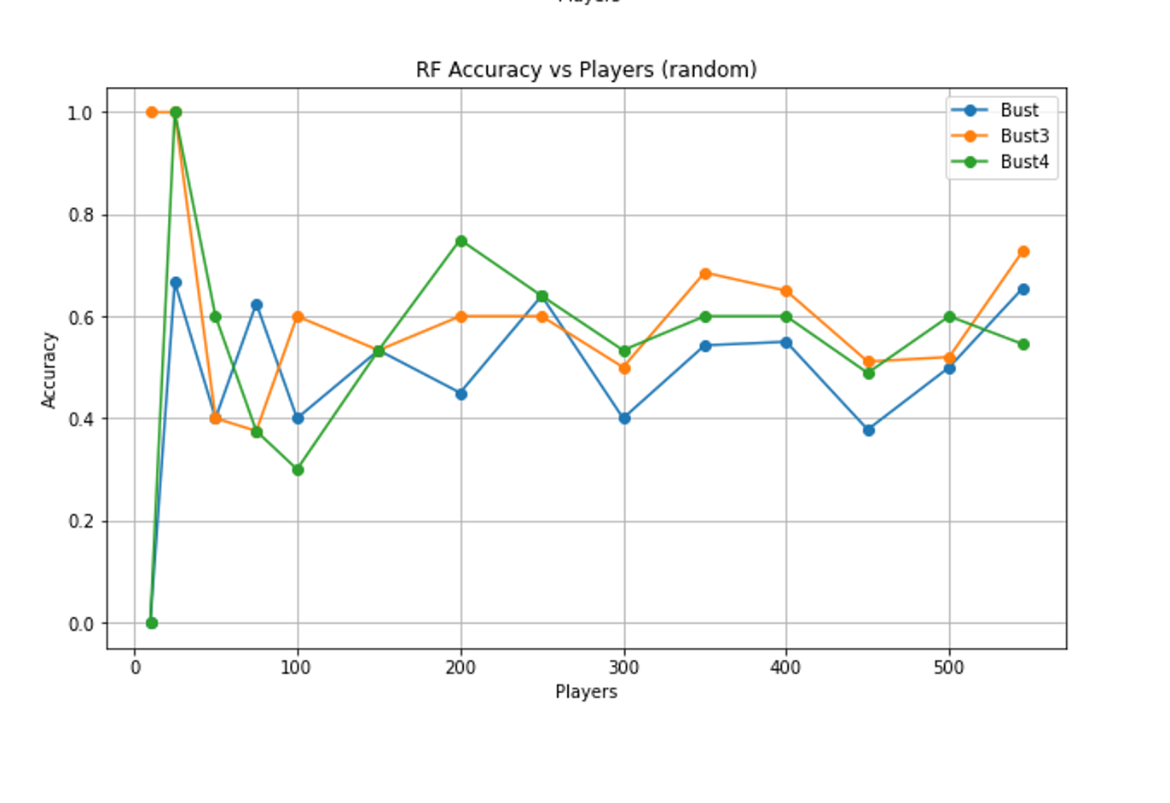

RF Comparison Testing
Skew!
545 | Bust1 | Bust3 | Bust4
Y | 0.488073 | 0.388991 | 0.458716
N | 0.517431 | 0.616514 | 0.546789
Bing image creator

Slide 10
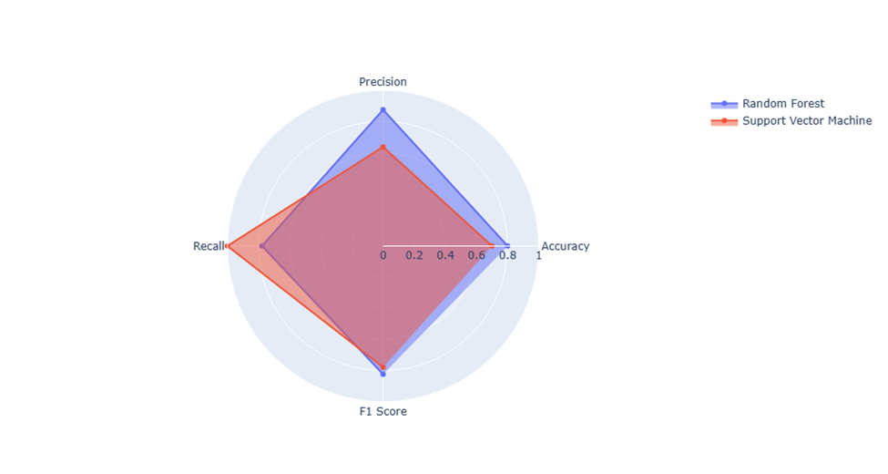
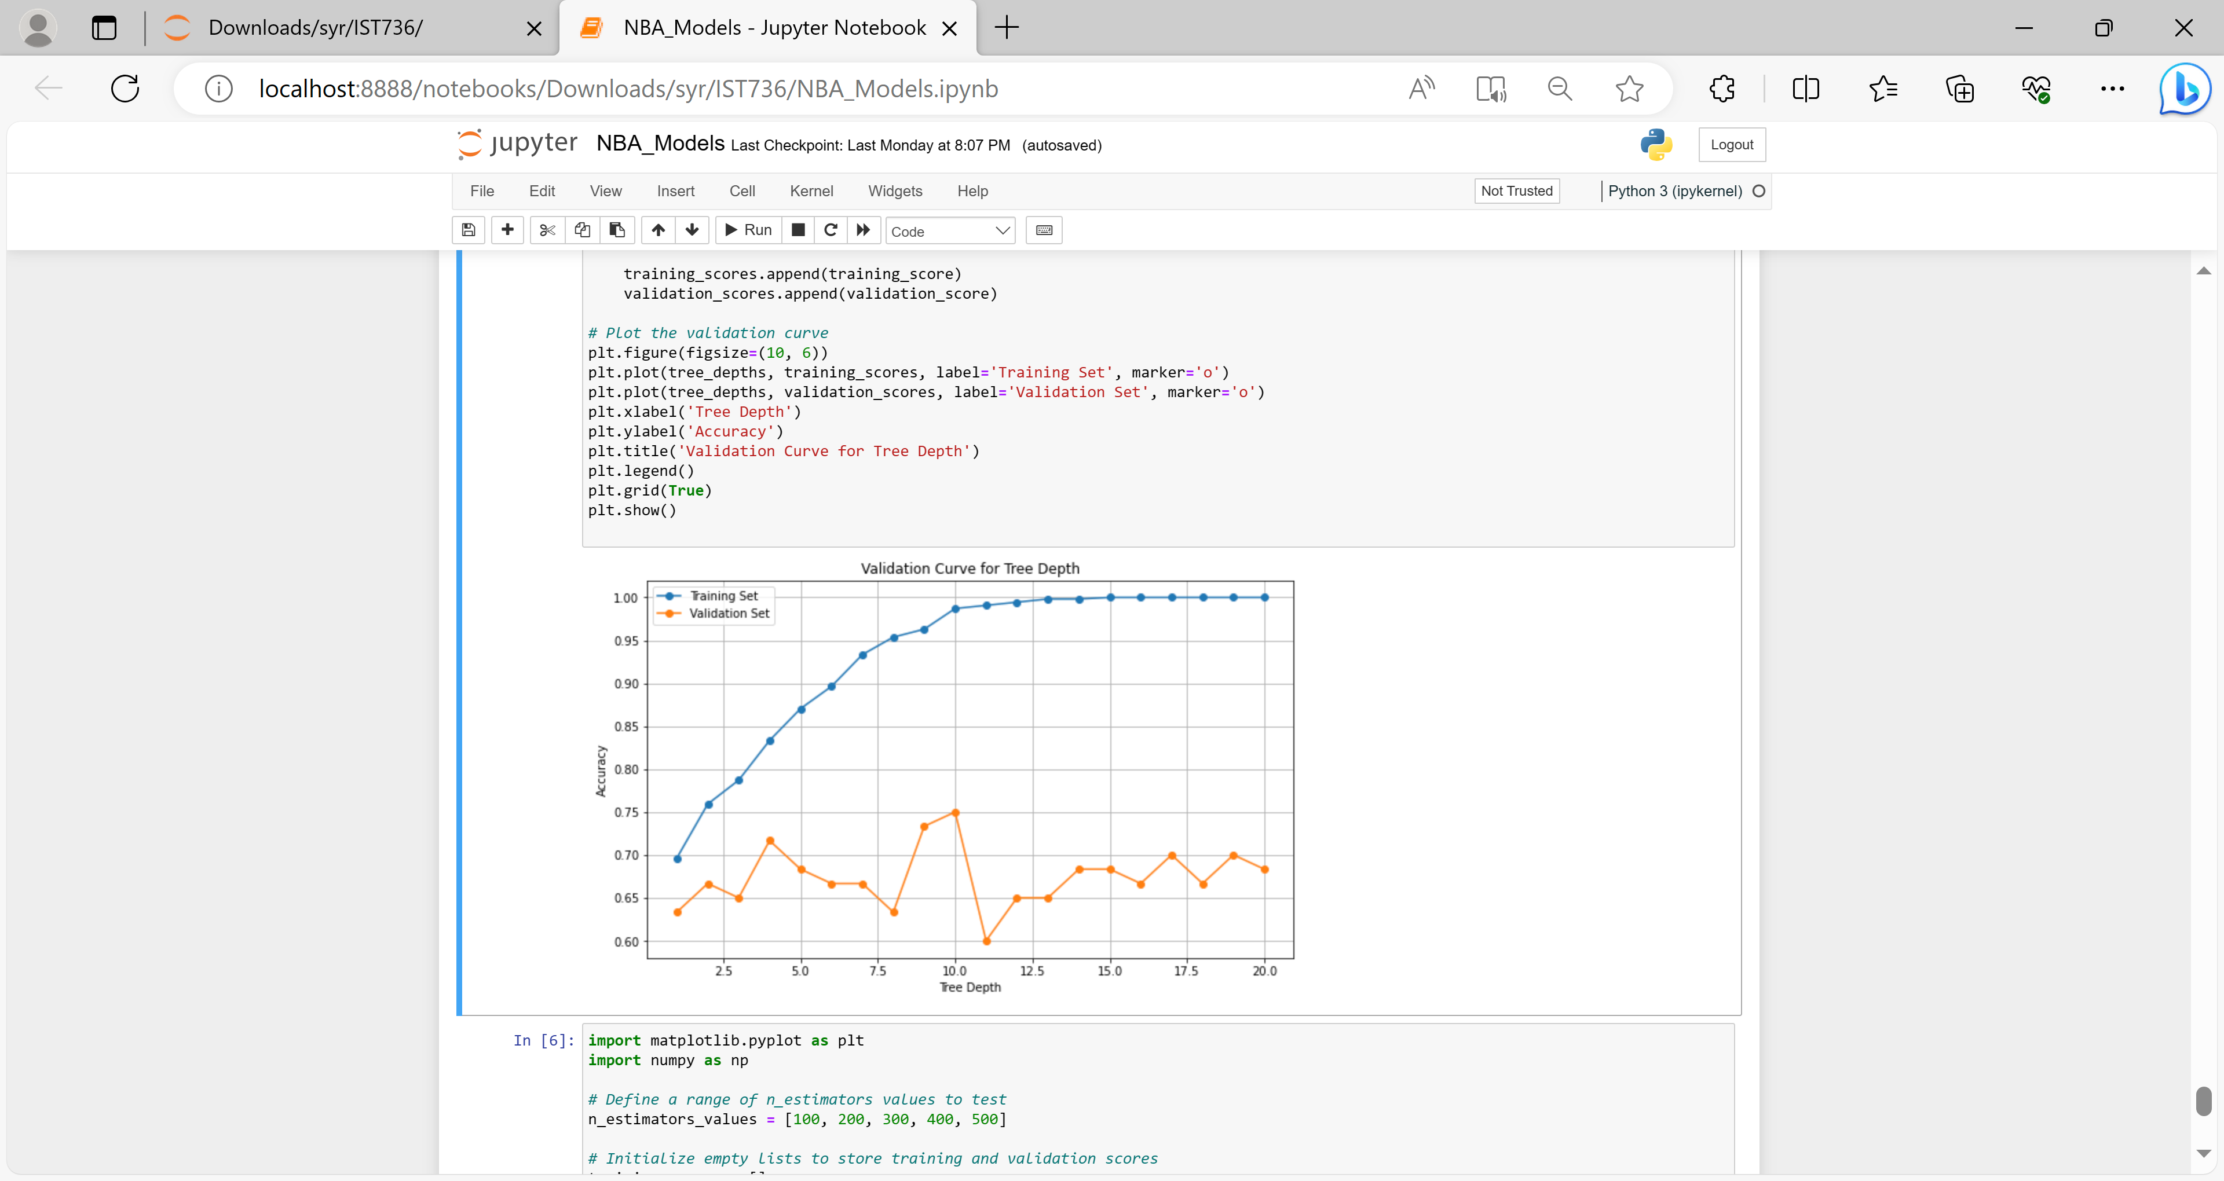
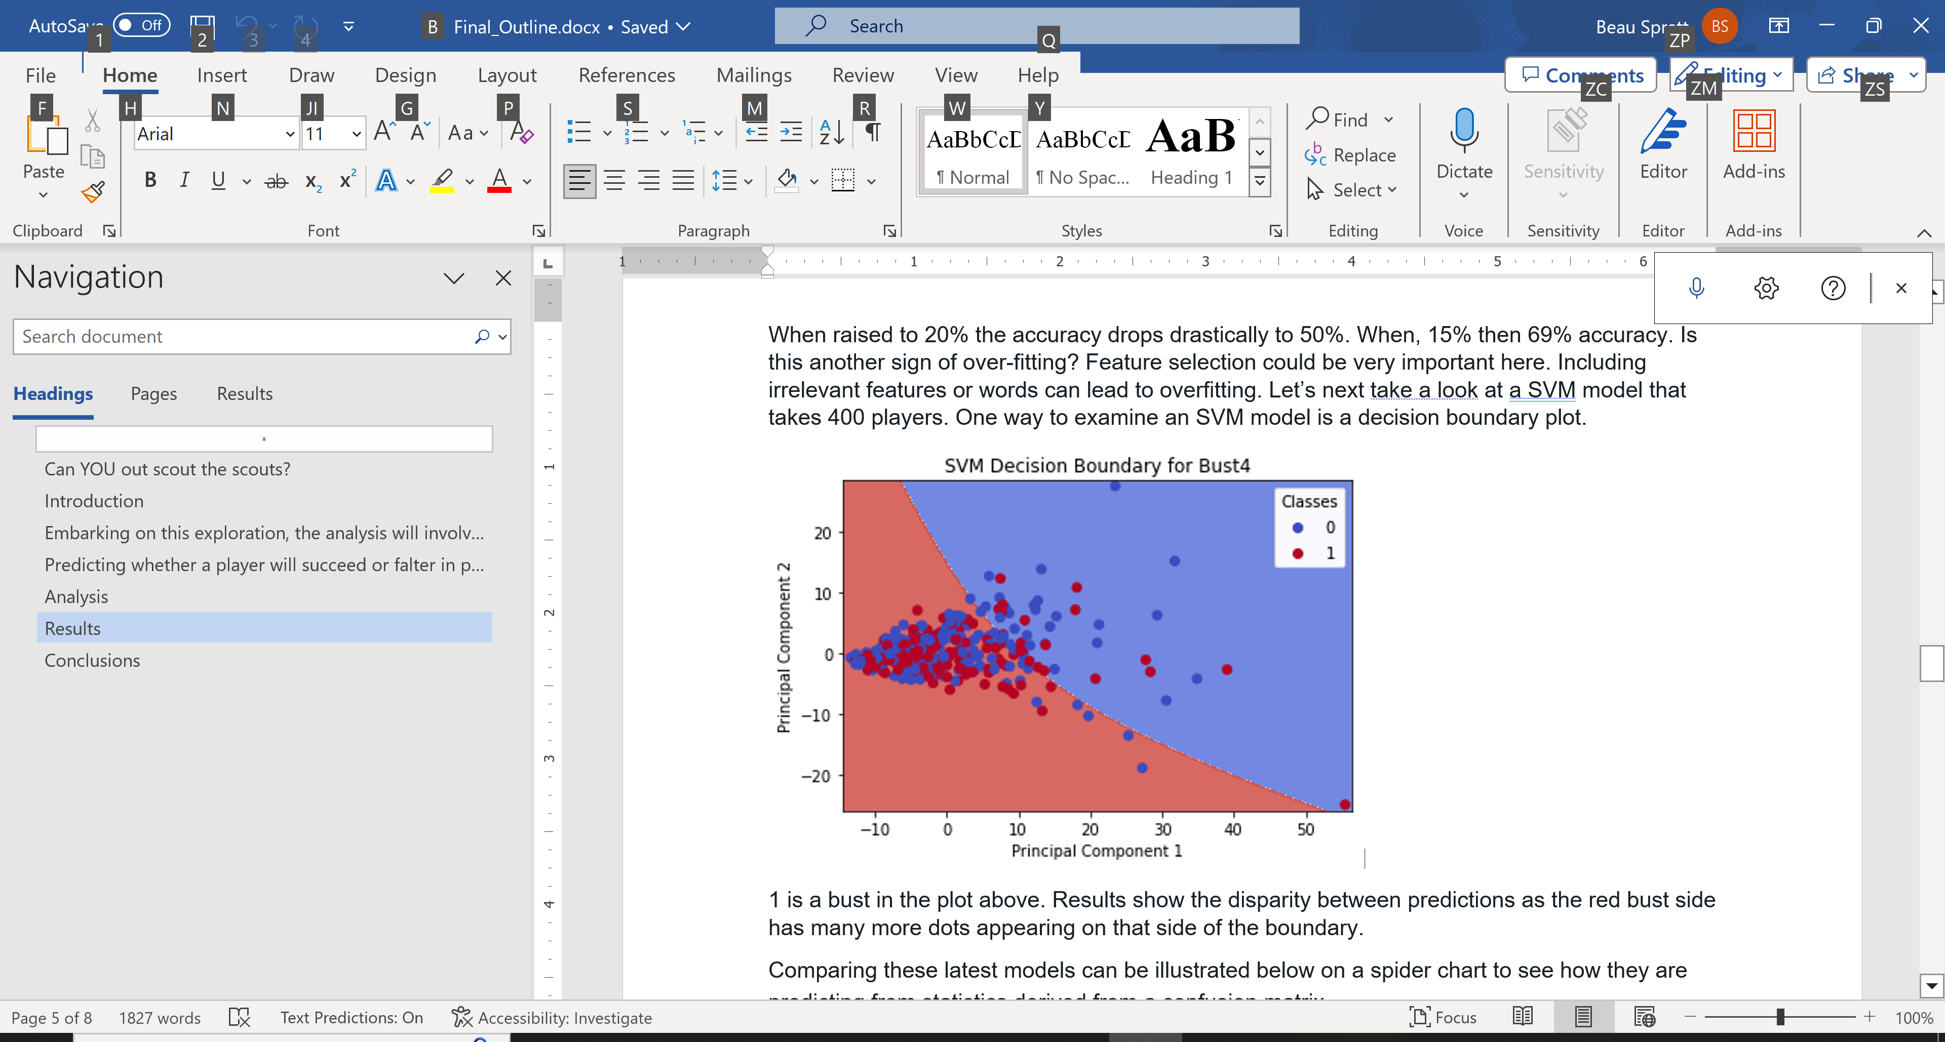

Fit for a prince? Overfitting RF-SVM
Bing image creator

Slide 11
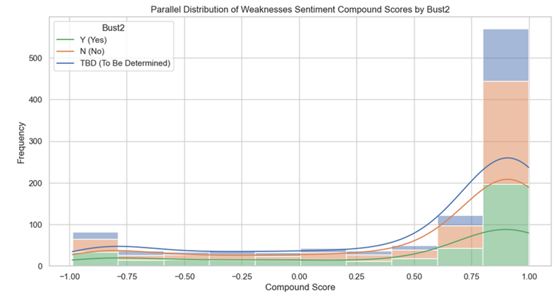
NBA Draft Sentiment Score Distribution on
- The majority of “bust” players have highly positive sentiment scores
- “Not” bust has the highest distribution overall among the positive scores while “yes” bust has the highest distribution among the very negative scores
Notes:
Still attempting to out scout the scouts, several sentiment analysis models were applied to the NBA draft data to determine if negative reviews and positive reviews provided by analysts, could be used as predictors and determine if a player will be successful or a “bust”.
The bar chart is showing that for this sample data, the majority of “bust” players have highly positive sentiment scores as seen in the green block of the last bar.
“yes” bust has the highest distribution among the very negative scores, though clearly small when compared to the entire dataset.
Next slides -

Slide 12
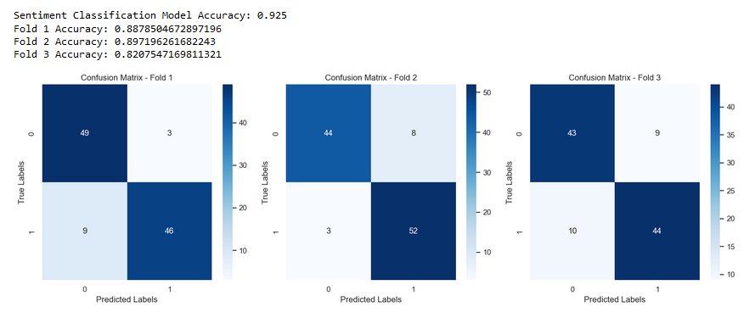
Model 2: SVM - Linear Kernel 3CV
Notes:
The poor results obtained while attempting to predict positive, negative and neutral sentiments let to models using only negative and positive classifications. Here the model performed much better with an overall accuracy of 92.5%. Across all the cross sections of the Supervised Vector Machines model the predictions were highly accurate for bot negative and positive labels

Slide 13
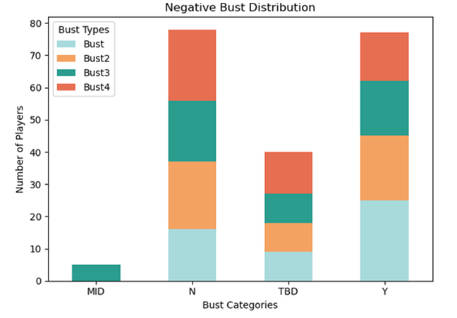
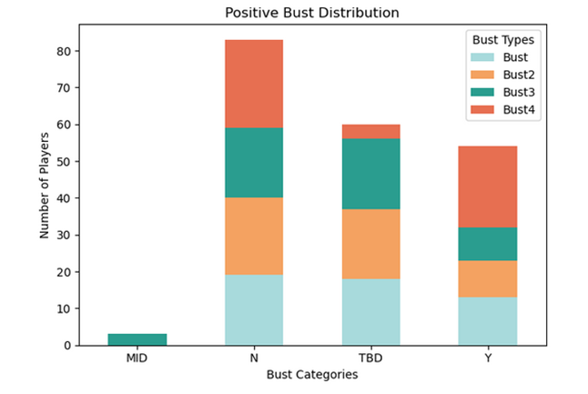
Sentiment Analysis to predict Player Success
Notes:
Some closing thoughts on Sentiment analysis to predict Draft Player success: based on our sample data while using negative and positive labels and top 100 positive and top 100 negative sentiment scores, it can be said that there is potential for this application. The distribution charts here confirm that there is a higher incidence of bust players among the negative sentiment scores than among the positive one. Although improvement should be made in the data collection for training purpurses.

Slide 14
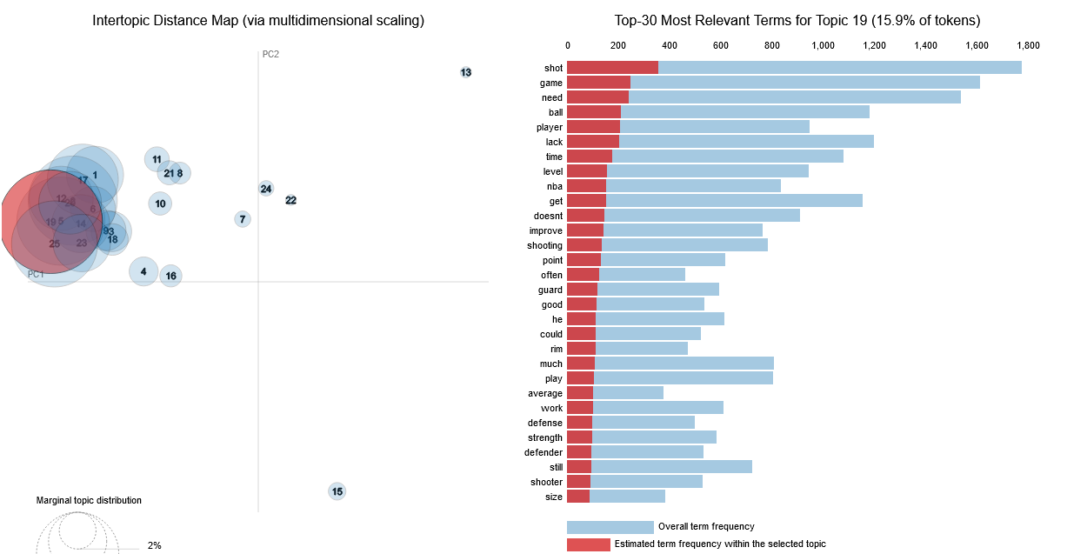

Slide 15
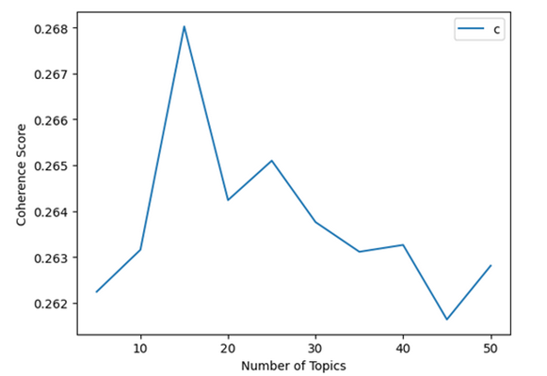
Model 5: Latent Dirichlet Allocation (LDA)
Main Themes:
Game and Skills: Topics #1, #2, #3, and #6 focus on aspects related to the players' performance in the game, including shooting, scoring, and defense
Strength and Physical Attributes: Topics #4, #9, and #15 emphasize the importance of strength, body control, and physicality in the players' game.
Shooting and Shooting Range: Topics #10, #12, #19, and #20 highlight the players' shooting abilities and range, including three-point shooting and midrange skills.
NBA and Professional Level: Topics #2, #3, #5, #7, and #17 mention the NBA and professional basketball, indicating that the players' readiness for the NBA or a similar level is a recurring theme.
- Grid search using Coherence Scores
pyLDAvis : file:///C:/Users/sinti/Syracuse%20University/IST-736/Final%20Project/LDA%20Analysis/lda_visualization.html
Ball Handling and Passing: Topics #13, #16, #21, and #22 touch on the players' ball-handling, passing, and playmaking abilities.
Notes:
http://localhost:8888/view/Syracuse%20University/IST-736/Final%20Project/LDA%20Analysis/lda_visualization.html
Another approach in the quest to extract insights from the NBA Draft Data was done by utilizing the Latent Dirichlet Allocation model.
When applied to the weaknesses analysis data using a grid search based on Coherence scores, 25 main topics were discovered. In this slide we are seeing the grid search plot and the original ten topics obtained prior to the grid search – where lots of repetition can be observed.
Post grid search – more detailed results can be seen following the URL to an interactive LDA visualization.
The PyLDAvis visualization, out of the 25 topics found, the distance between bubbles is much smaller when compared to the first scenario. This indicates the degree of similarity or dissimilarity between topics.
When two bubbles are positioned close to each other, it suggests that the topics they represent share similar terms and are more related to each other. The opposite is true when they are far apart. Furthermore, the frequency and relevance of words within each of the 25 topics is represented in the bar chart. The larger the bubble the higher the frequency and the more significant the words are within the collection.
The goal of this model was to identify common themes among the analysts' reviews. Though we don’t have time to cover it here several were identified from the LDA
For example
Game and Skills: Topics #1, #2, #3, and #6 focus on aspects related to the players' performance in the game, including shooting, scoring, and defense.
Strength and Physical Attributes: Topics #4, #9, and #15 emphasize the importance of strength, body control, and physicality in the players' game. This suggests a focus on the players' physical attributes and their impact on performance.
By harnessing these extracted topics and their prevalence in player weaknesses, analysts can build predictive models that consider the influence of these themes on players' future success or struggles in the NBA.

Slide 16
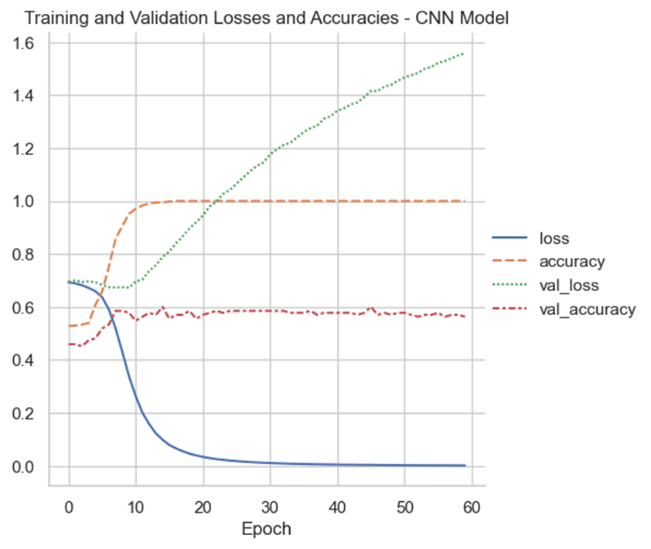
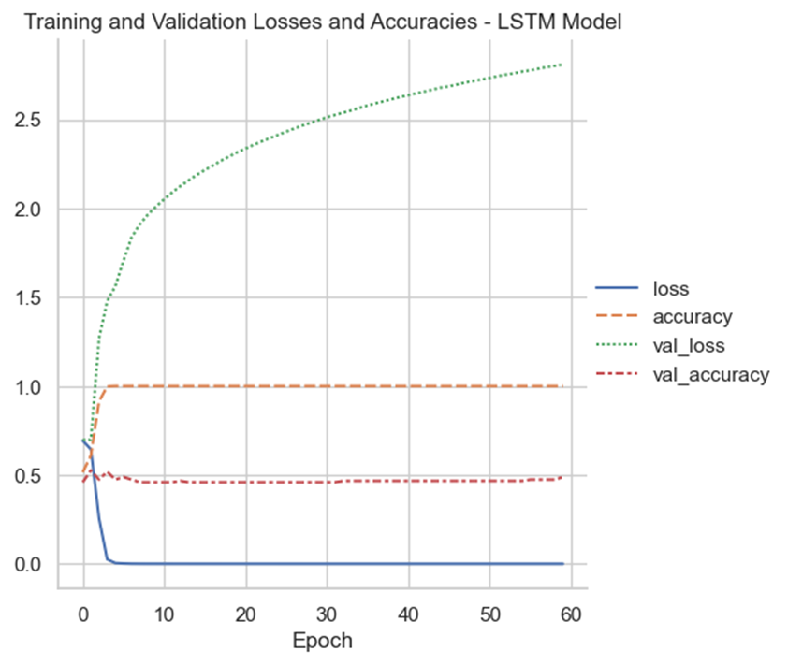
CNN vs. LSTM (plain)

Slide 17
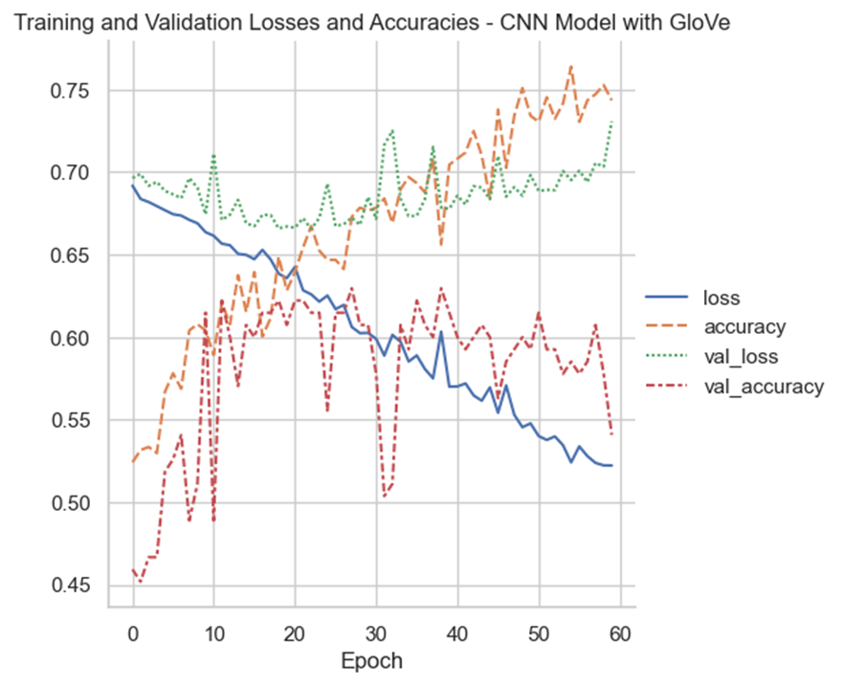
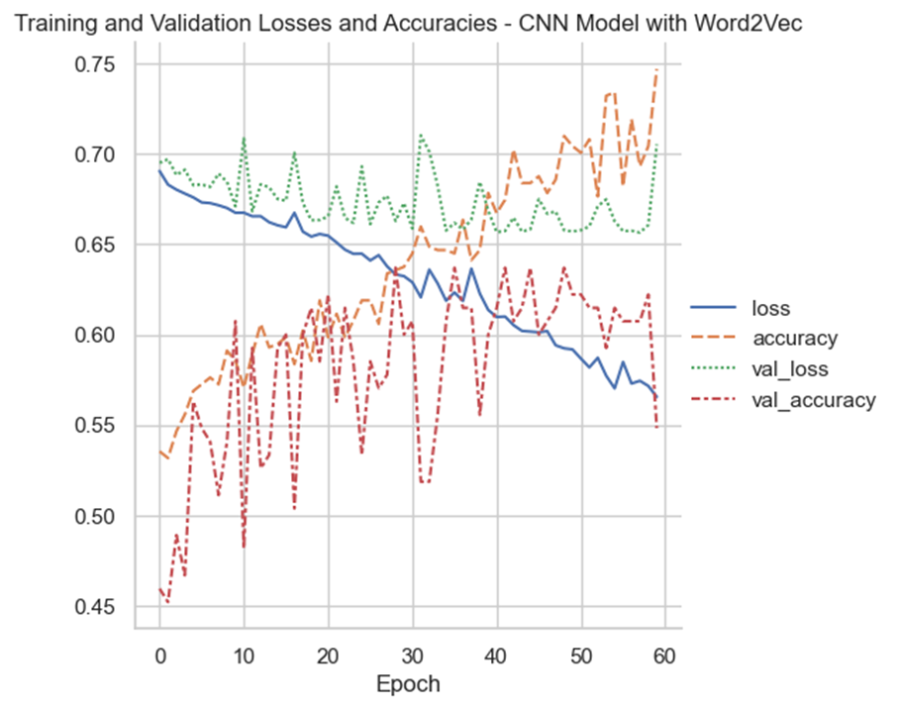
CNN (GloVe vs. Word2Vec Embeddings)

Slide 18
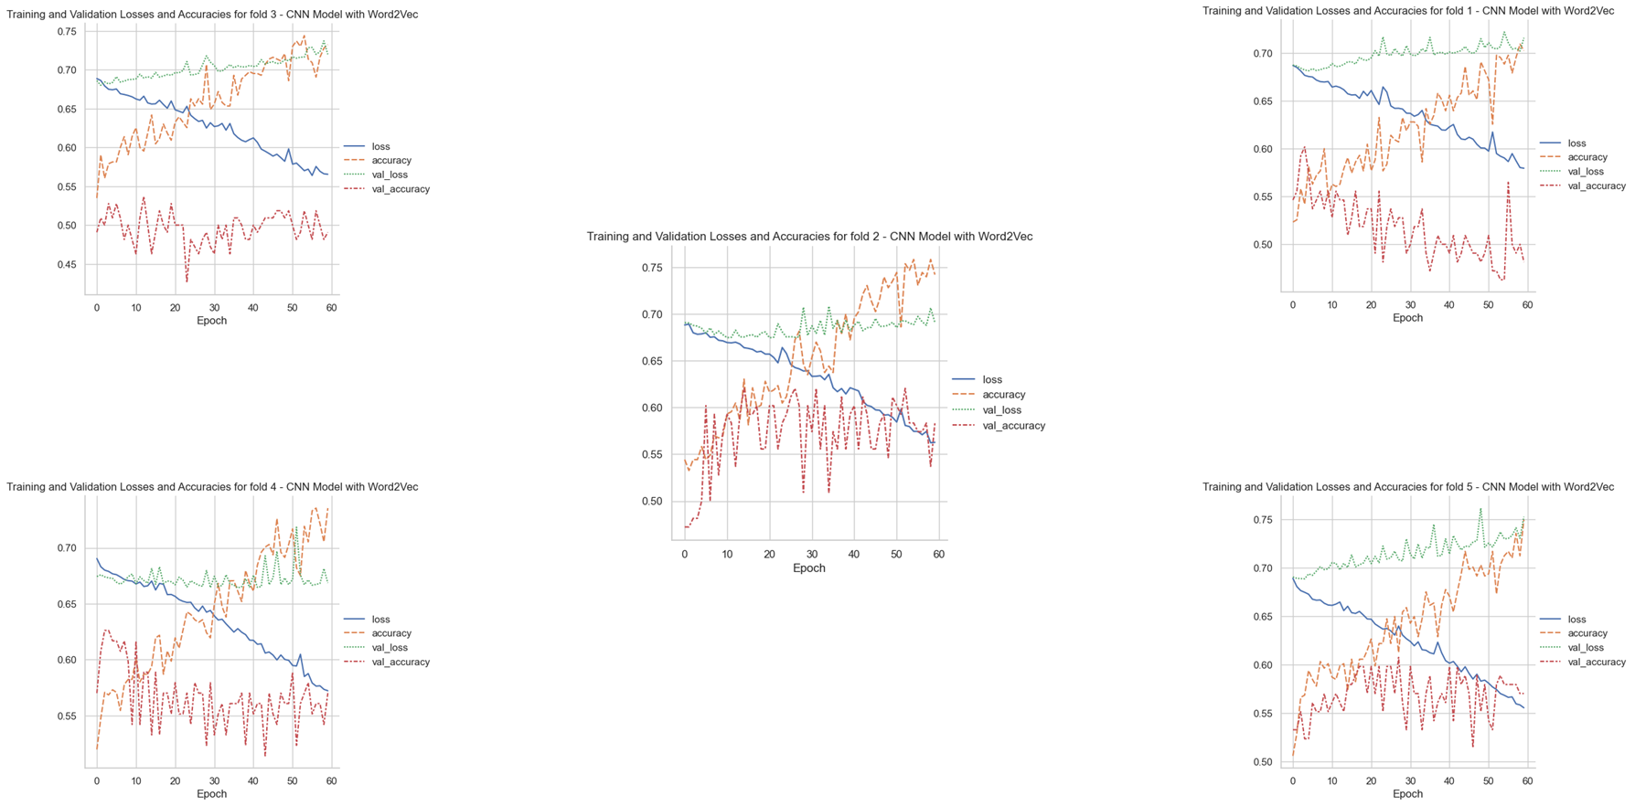
CCN with Word2Vec Embeddings – 5-fold Cross Validation Training/Validation

Slide 19
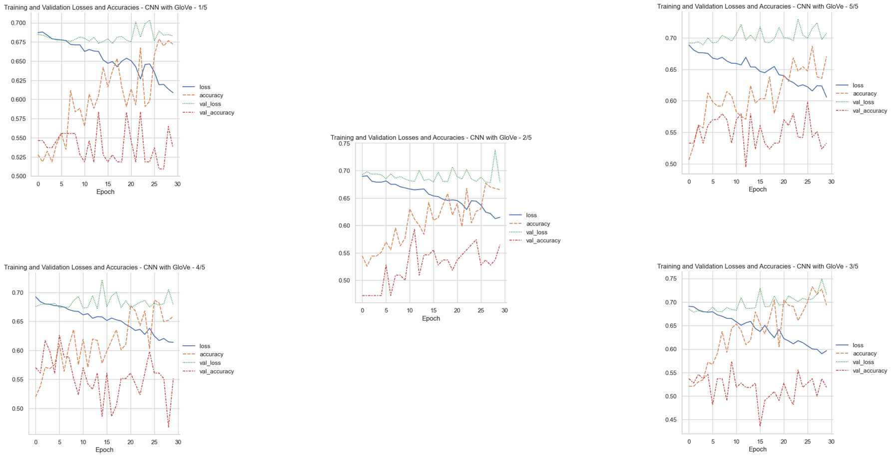
CCN with GloVe Embeddings – 5-fold Cross Validation Training/Validation

Slide 20
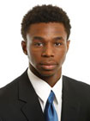
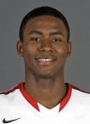
Combined Features – Swipe Left? Or Right? NB, DT, S
Top N-grams for label 'N':
standing reach
high school
jordan brand
brand classic
ball handler
next level
Top N-grams for label 'Y':
good job
ball handling
need improve
first step
jump shot
feel game
Top Branches:
instant >0.443
stance<=0.848
Top Branches:
detail >0.186
school>1.5
+ Sentiment Score
- Sentiment Score

Slide 21

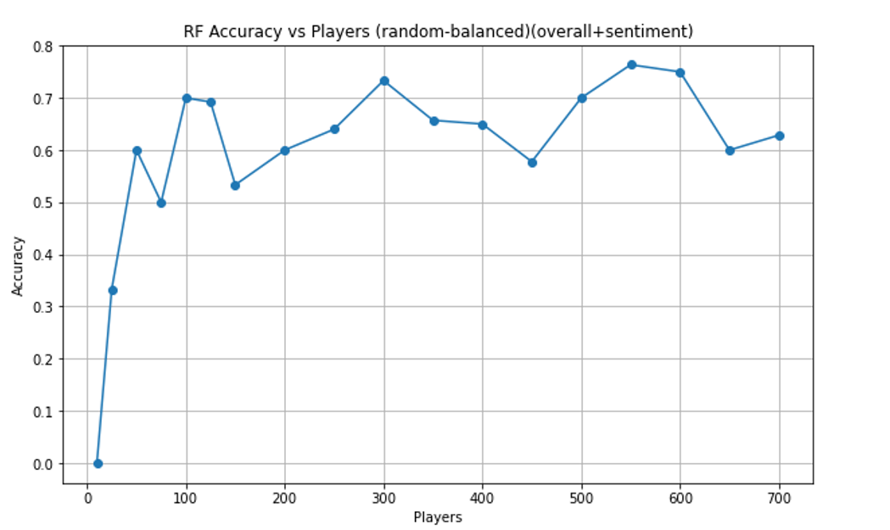
Crystal Ball Predictions
Player | Predicted Bust
Victor Wembanyama | N
Jalen Pickett | Y
Jalen Wilson | Y
Scoot Henderson | Y
Julian Strawther | Y
Leonard Miller | N
Jaime Jaquez Jr | Y
Kris Murray | N
Marcus Sasser | Y
Isaiah Wong | Y
Trayce Jackson-Davis | Y
Mouhamed Gueye | Y
Sidy Cissoko | Y
Mojave King | Y
Bing image creator
Sweet Spot!

Slide 22
Conclusions
Low accuracy is concerning but at least teams can use these predictions as a player barometer or an automated way to consume lots of scouting reports.
More data from a variety of scouting sources. Features from scout like day-to-day life, work ethic, personality traits, where did they play? Body types vs position. Athletics features.
Cleaner models. Avoid over or under fitting, perform tuning. More cross-validation testing.

Slide 23

Questions?

